Slide 1


Regular Expressions (RegEx)
Regular Expressions Language Syntax
SoftUni Team
Technical Trainers
Software University
https://softuni.bg

Slide 2
Table of Contents
Regular Expressions Syntax
Definition and Pattern
Predefined Character Classes
Quantifiers and Grouping
Backreferences
Regular Expressions in Java

Slide 3
Have a Question?
sli.do
#fund-java

Slide 4
Regular Expressions
[A-Z]
Definition and Classes

Slide 5
What Are Regular Expressions?
Regular expressions (regex)
Match text by pattern
Patterns are defined by special syntax, e.g.
[0-9]+ matches non-empty sequence of digits
[A-Z][a-z]* matches a capital + small letters
Play with regex live at: regexr.com, regex101.com

Slide 6
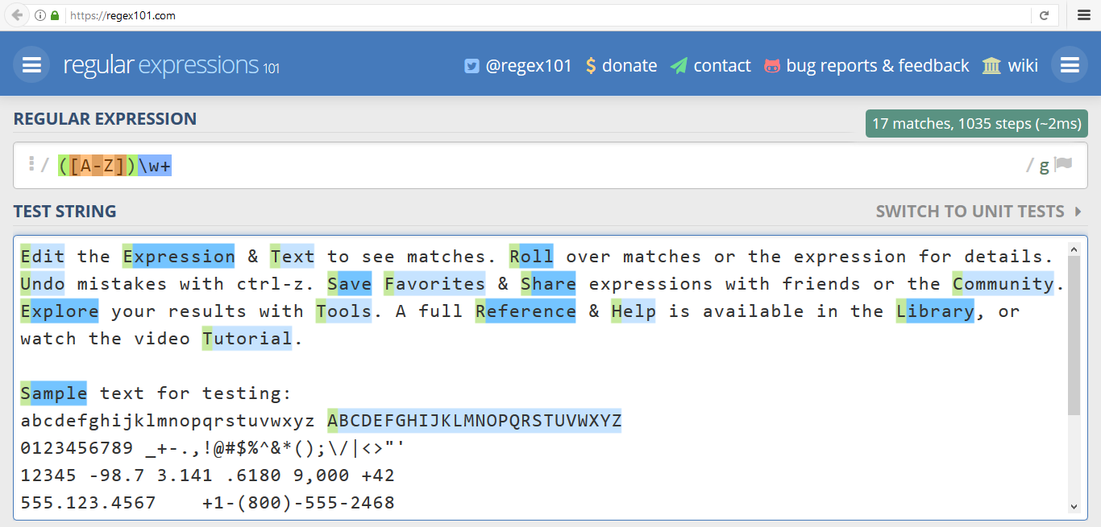
Live Demo
Www.regex101.com

Slide 7
Regular Expression Pattern – Example
Regular expressions (regex) describe a search pattern
Used to find / extract / replace / split data from text by pattern
[A-Z][a-z]+ [A-Z][a-z]+
John Smith
Linda Davis
Contact: Alex Scott

Slide 8
Character Classes: Ranges
[nvj] matches any character that is either n, v or j
[^abc] - matches any character that is not a, b or c
[0-9] - character range matches any digit from 0 to 9
node.js v0.12.2
Abraham
John is 8 years old.

Slide 9
Predefined Classes
\w - matches any word character (a-z, A-Z, 0-9, _)
\W - matches any non-word character (the opposite of \w)
\s - matches any white-space character
\S - matches any non-white-space character (opposite of \s)
\d - matches any decimal digit (0-9)
\D - matches any non-decimal character (the opposite of \d)

Slide 10
Quantifiers
(\w+)
Grouping

Slide 11
Quantifiers
* - matches the previous element zero or more times
+ - matches the previous element one or more times
? - matches the previous element zero or one time
{3} - matches the previous element exactly 3 times
\+\d*
+359885976002 a+b
\+\d+
+359885976002 a+b
\+\d?
+359885976002 a+b
\+\d{3}
+359885976002 a+b

Slide 12
Grouping Constructs
(subexpression) - captures the matched subexpression as numbered group
(?:subexpression) - defines a non-capturing group
(?<name>subexpression) - defines a named capturing group
\d{2}-(\w{3})-\d{4}
22-Jan-2015
^(?:Hi|hello),\s*(\w+)$
Hi, Peter
(?<day>\d{2})-(?<month>\w{3})-(?<year>\d{4})
22-Jan-2015

Slide 13
Problem: Match All Words
Write a regular expression in www.regex101.com that extracts all word char sequences from given text
_ (Underscores) are also word characters!
_|Underscores|are|also|word|characters

Slide 14
Problem: Match Dates
Write a regular expression that extracts dates from text
Valid date format: dd-MMM-yyyy
Examples: 12-Jun-1999, 3-Nov-1999
I am born on 30-Dec-1994.
My father is born on the 9-Jul-1955.
01-July-2000 is not a valid date.

Slide 15
Problem: Email Validation
Write a regular expression that performs simple email validation
An email consists of username @ domain name
Usernames are alphanumeric
Domain names consist of two strings, separated by a period
Domain names may contain only English letters
Valid:
Invalid:
valid123@email.bg
invalid*name@emai1.bg

Slide 16
Backreferences
\1
Numbered Capturing Group

Slide 17
Backreferences Match Previous Groups
\number - matches the value of a numbered capture group
<(\w+)[^>]*>.*?<\/\1>
<b>Regular Expressions</b> are cool!
<p>I am a paragraph</p> … some text after
Hello, <div>I am a<code>DIV</code></div>!
<span>Hello, I am Span</span>
<a href="https://softuni.bg/">SoftUni</a>

Slide 18

Regular Expressions
Using Built-In Regex Classes

Slide 19
Regex in Java
Regex in Java library
java.util.regex.Pattern
java.util.regex.Matcher
Pattern pattern = Pattern.compile("a*b");
Matcher matcher = pattern.matcher("aaaab");
boolean match = matcher.find();
String matchText = matcher.group();
Searches for the next match
Gets the matched text

Slide 20
Checking for a Single Match
find() - gets the first pattern match
String text = "Andy: 123";
String pattern = "([A-Z][a-z]+): (?<number>\\d+)";
Pattern regex = Pattern.compile(pattern);
Matcher matcher = regex.matcher(text);
System.out.println(matcher.find()); // true
System.out.println(matcher.group()); // Andy: 123
System.out.println(matcher.group(0)); // Andy: 123
System.out.println(matcher.group(1)); // Andy
System.out.println(matcher.group(2)); // 123
System.out.println(matcher.group("number")); // 123
+ - Matches the element one or more times

Slide 21
Replacing with Regex
To replace every/first subsequence of the input sequence that matches the pattern with the given replacement string
replaceAll(String replacement)
replaceFirst(String replacement)
String regex = "[A-Za-z]+";
String string = "Hello Java";
Pattern pattern = Pattern.compile(regex);
Matcher matcher = pattern.matcher(string);
String res = matcher.replaceAll("hi"); // hi hi
String res2 = matcher.replaceFirst("hi"); // hi Java

Slide 22
Splitting with Regex
split(String pattern) - splits the text by the pattern
Returns String[]
String text = "1 2 3 4";
String pattern = "\\s+";
String[] tokens = text.split(pattern);
Matches whitespaces
tokens = {"1", "2", "3", "4"}

Slide 23
Problem: Match Full Name
You are given a list of names
Match all full names
Ivan Ivanov, Ivan ivanov, ivan Ivanov, IVan Ivanov, Test Testov, Ivan Ivanov
Ivan Ivanov Test Testov
Check your solution here: https://judge.softuni.bg/Contests/1672/

Slide 24
Solution: Match Full Names
String listOfNames = reader.readLine();
String regex = "\\b[A-Z][a-z]+ [A-Z][a-z]+";
Pattern pattern = Pattern.compile(regex);
Matcher matcher = pattern.matcher(listOfNames);
while (matcher.find()) {
System.out.print(matcher.group() + " ");
}
Check your solution here: https://judge.softuni.bg/Contests/1672/
Notes:
You can try also: @"<a.*href=((?:.|\n)*?(?=>))>((?:.|\n)*?(?=<))<\/a>"

Slide 25
Problem: Match Dates
You are given a string
Match all dates in the format "dd{separator}MMM{separator}yyyy" and print them space-separated
13/Jul/1928, 01/Jan-1951
Day: 13, Month: Jul, Year: 1928
Check your solution here: https://judge.softuni.bg/Contests/1672/

Slide 26
Solution: Match Dates
String input = reader.readLine();
String regex = "\\b(?<day>\\d{2})(\\.|\\/|\\-)(?<month>[A-Z][a-z]{2})\\2(?<year>\\d{4})\\b";
Pattern pattern = Pattern.compile(regex);
Matcher matcher = pattern.matcher(dates);
while (matcher.find()) {
System.out.println(String.format("Day: %s, Month: %s, Year: %s",
matcher.group("day"), matcher.group("month"), matcher.group("year")));
}
Check your solution here: https://judge.softuni.bg/Contests/1672/
Notes:
You can try also: @"<a.*href=((?:.|\n)*?(?=>))>((?:.|\n)*?(?=<))<\/a>"

Slide 27
Helpful Resources
https://regex101.com and http://regexr.com - websites to test Regex using different programming languages
https://docs.oracle.com/javase/7/docs/api/java/util/regex/Matcher.html - a quick reference for Regex from Oracle
http://regexone.com - interactive tutorials for Regex
http://www.regular-expressions.info/tutorial.html - a comprehensive tutorial on regular expressions

Slide 28

Summary
…
…
…
Regular expressions describe patterns for searching through text
Define special characters, operators and constructs for building complex pattern
Can utilize character classes, groups, quantifiers and more

Slide 29
Questions?
Notes:
29

Slide 30












SoftUni Diamond Partners

Slide 31


Educational Partners

Slide 32
Trainings @ Software University (SoftUni)
Software University – High-Quality Education, Profession and Job for Software Developers
softuni.bg, about.softuni.bg
Software University Foundation
softuni.foundation
Software University @ Facebook
facebook.com/SoftwareUniversity
Software University Forums
forum.softuni.bg
Notes:
32

Slide 33

License
This course (slides, examples, demos, exercises, homework, documents, videos and other assets) is copyrighted content
Unauthorized copy, reproduction or use is illegal
© SoftUni – https://about.softuni.bg/
© Software University – https://softuni.bg
Notes:
33

